Slide 1


<Ruby Kalha>
<30/9/2022>

Slide 2

Outline
Executive Summary
Introduction
Methodology
Results
Conclusion
Appendix

Slide 3
Executive Summary
Summary of methodologies:
Data Collection through API,Web Scraping
Data Wrangling
Exploratory Data Analysis with SQL and Data Visualization
Interactive Visual Analytics with Folium
Machine Learning Prediction
Summary of all results
Exploratory Data Analysis (EDA) results
Data Analysis with screenshots of visualizations
Predictive Analytics result

Slide 4
Introduction
Project background and context:
Space X advertises Falcon 9 rocket launches on its website with a cost of 62 million dollars; other providers cost upward of 165 million dollars each, much of the savings is because Space X can reuse the first stage. Therefore, if we can determine if the first stage will land, we can determine the cost of a launch. Our goal is to create a machine learning pipeline to predict if the first stage will land successfully.
Problems you want to find answers:
What factors ensure a successful landing of the rocket?
The relationship between various features that determine the success rate of a landing.
What conditions need to be in place to achieve the best results?

Slide 5

Section 1

Slide 6
Methodology
Executive Summary
Data collection methodology:
Data was collected using:
SpaceX API
web scraping from Wikipedia.
Perform data wrangling
One-hot encoding (to categorical features)
Dropping irrelevant columns
Perform exploratory data analysis (EDA) using visualization and SQL:
Scatter Plots
Bar Graphs

Slide 7
Perform interactive visual analytics using:
Folium
Plotly Dash
Perform predictive analysis using classification models
Build, tune and evaluate classification models

Slide 8
Data Collection
Data Collection meaning:
It is the procedure of collecting, measuring and analyzing accurate insights for research using standard validated techniques to answer questions and evaluate outcomes.
Data Collection basic steps:
Collect data from API and web pages.
Create dataframe of it.
Clean and filter the dataframe.
Export to flat file (csv).

Slide 9
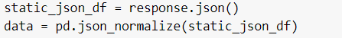
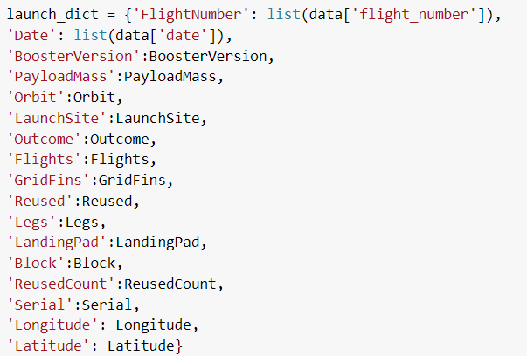
Data Collection – SpaceX API
Our objective is to extract the launch records as HTML table, parse the table, and convert it to a pandas dataframe for future analysis.
Collect the data using get request to the SpaceX API.
Convert the response content as a Json file using .json() function call and turn it into a pandas dataframe using.json_normalize().
Clean the data, check for missing values and fill in missing values where necessary.
Ceate the dataframe using dictionary.
Filter the dataframe and export it to a CSV file.
Notebook: https://github.com/rubylouai/final/blob/main/Collecting%20the%20Data-%20Collection%20API%20Lab.ipynb.ipynb

Slide 10
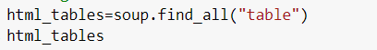
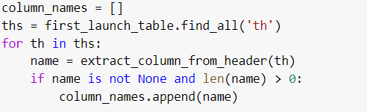
Data Collection - Scraping
Apply web scrapping to Falcon 9 launch records from Wikipedia with BeautifulSoup.
Get response from HTML
Create a BeautifulSoup object and sparse tables.
Create dictionary with the column names and appending data to them.
Convert dictionary to dataframe and export it to csv file.
Notebook: https://github.com/rubylouai/final/blob/main/webscraping%20(1).ipynb

Slide 11

Data Wrangling
Data Wrangling Basic steps:
Load Data.
Make Dataframe from it.
Clean Data.
Covert it to Boolean values.
Export to flat file.
Determine training labels.
Notebook: https://github.com/rubylouai/final/blob/main/Data%20Wrangling%20-%20EDA%20lab.ipynb

Slide 12
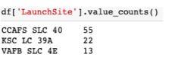
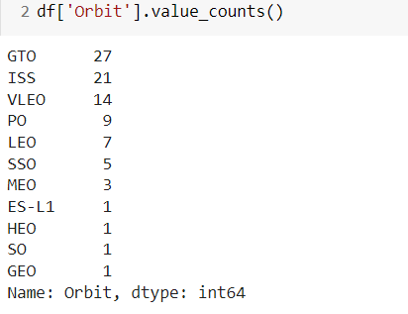
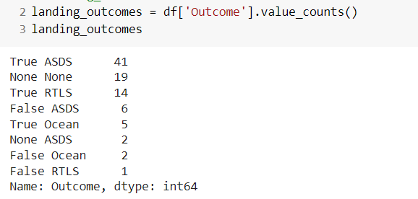
Data Wrangling
Data Wrangling steps:
Calculate the number of launches at each site.
Calculate the number of launches at each orbit.
Calculate the number and occurrence of mission outcomes per orbit type.
Create landing outcome label from outcome column
export the results to CSV file.

Slide 13
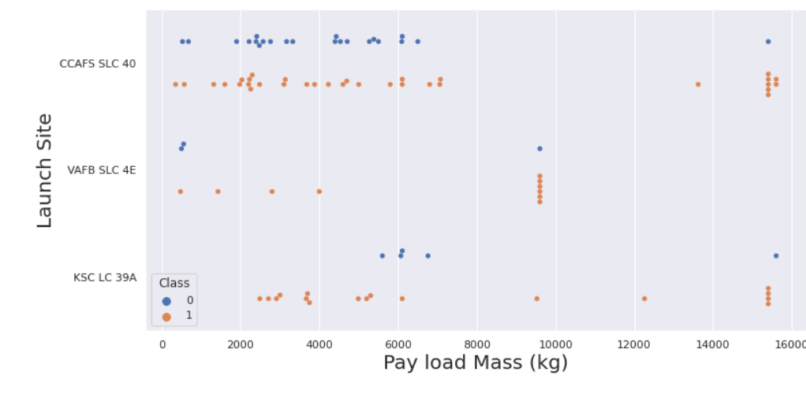
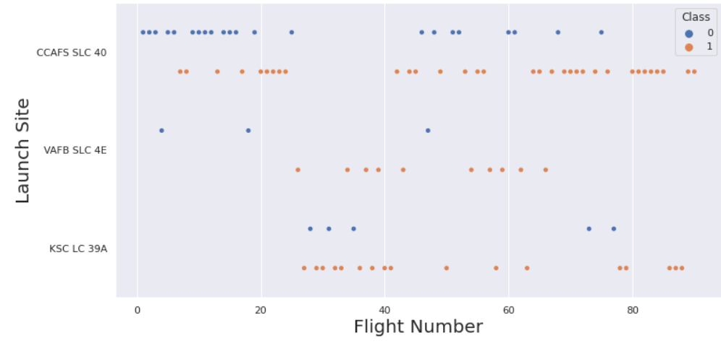
EDA with Data Visualization
Scatter Plots between:
Payload and Flight number/ Flight number and launch site/ payload and launch site / Flight number and Orbit type/ Payload and Orbit type

Slide 14
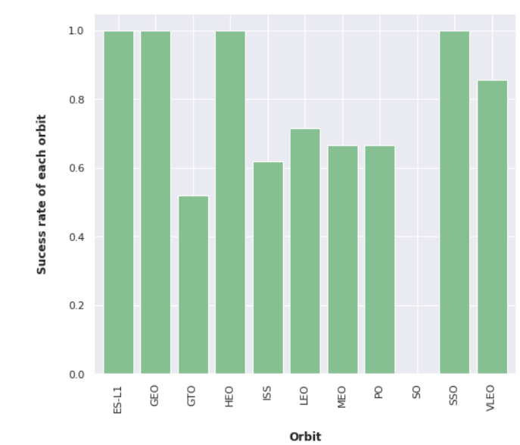
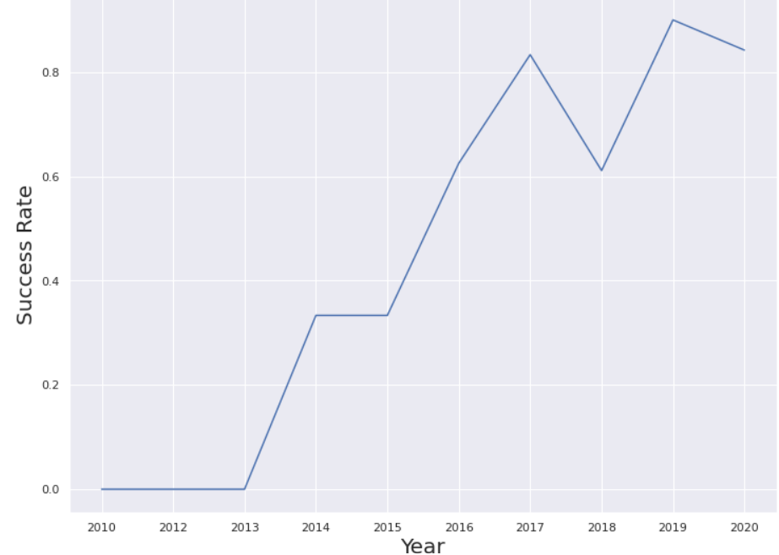
EDA with Data Visualization
Bar Graph between:
Success Rate and Orbit type.
Line Graph:
Applied to Launch Success yearly trend.
Notebook: https://github.com/rubylouai/final/blob/main/EDA%20with%20Visualization%20lab.ipynb

Slide 15
EDA with SQL
SQL is Structured Query Language, which is a computer language for storing, manipulating and retrieving data stored in a relational database. Here we loaded the SpaceX dataset into a PostgreSQL database.
We performed SQL queries to get insight from the data:
Display the names of unique launch sites in the space mission.
The total payload mass carried by boosters launched by NASA (CRS)
The average payload mass carried by booster version F9 v1.1
The total number of successful and failure mission outcomes
The failed landing outcomes in drone ship, their booster version and launch site names.
Notebook: https://github.com/rubylouai/final/blob/main/Exploratory%20Data%20Analysis%20Using%20SQL.ipynb

Slide 16
Build an Interactive Map with Folium
Folium makes it easy to visualize data that's been manipulated in Python on an interactive leaflet map.
We marked all launch sites, and added map objects such as markers, circles, lines to mark the success or failure of launches for each site on the folium map.
Using the color-labeled marker clusters, we identified which launch sites have relatively high success rate.
We calculated the distances between a launch site to its proximities.
Notebook: https://github.com/rubylouai/final/blob/main/Interactive%20Visual%20Analytics%20with%20Folium.ipynb

Slide 17
Build a Dashboard with Plotly Dash
We built an interactive dashboard with Plotly dash
We plotted pie charts showing the total launches by a certain sites
We plotted scatter graph showing the relationship with Outcome and Payload Mass (Kg) for the different booster version.
Notebook: https://github.com/rubylouai/final/blob/main/plotly.py

Slide 18
Predictive Analysis (Classification)
We loaded the data using numpy and pandas, transformed the data, split our data into training and testing.
We built different machine learning models and tune different hyperparameters using GridSearchCV.
We used accuracy as the metric for our model, improved the model using feature engineering and algorithm tuning.
We found the best performing classification model.
Notebook: https://github.com/rubylouai/final/blob/main/Machine%20Learning%20Prediction%20Lab.ipynb

Slide 19
Results
Exploratory data analysis results
Interactive analytics demo in screenshots
Predictive analysis results

Slide 20

Section 2

Slide 21
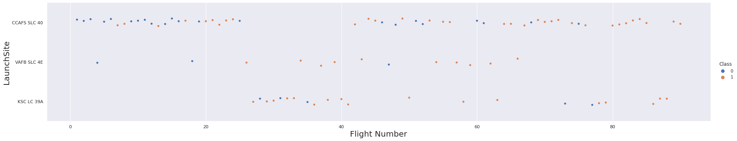
Flight Number vs. Launch Site
The higher the Flight number the success rate for the Rocket increases

Slide 22
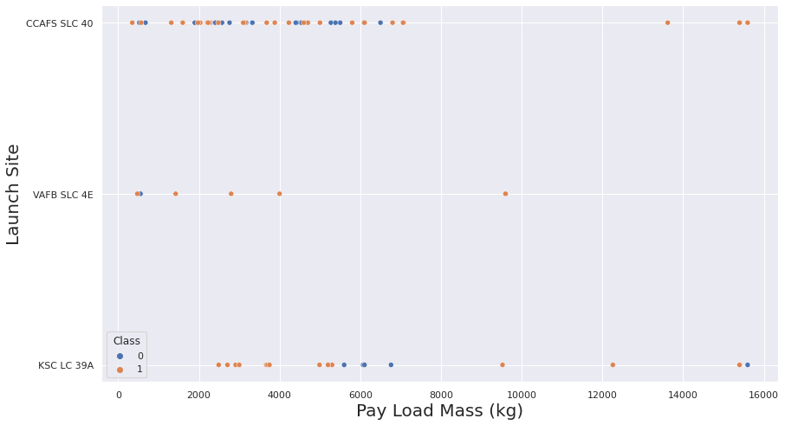
Payload vs. Launch Site
The greater the payload mass (greater than 7000 kg) higher the success rate of the rocket. But there’s no clear pattern to take a decision if the launch site is dependent on Pay Load Mass for a successful launch.

Slide 23
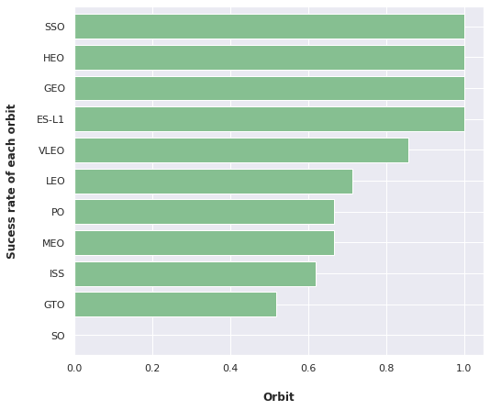
Success Rate vs. Orbit Type
ES-L1 ,GEO,HEO,SSO has the highest Success rates

Slide 24
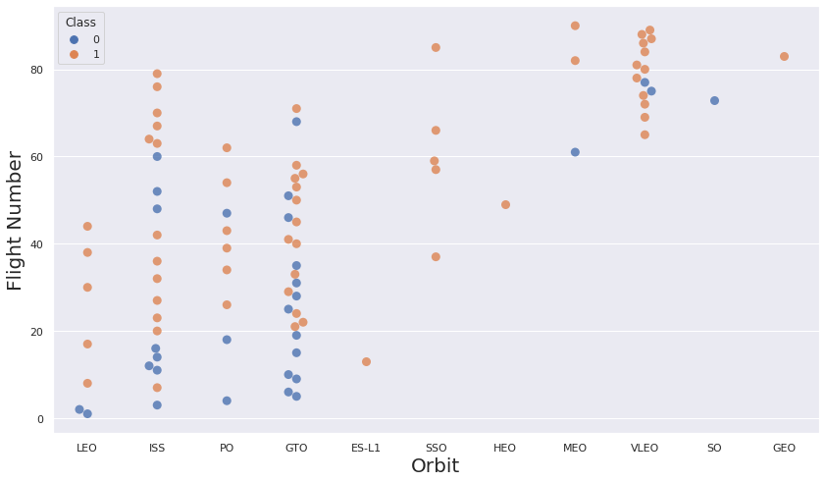
Flight Number vs. Orbit Type
We see that for Leo orbit the success increases with the number of the flights
On the other hand ,there seems to be no relationship between flight number and GTO orbit

Slide 25
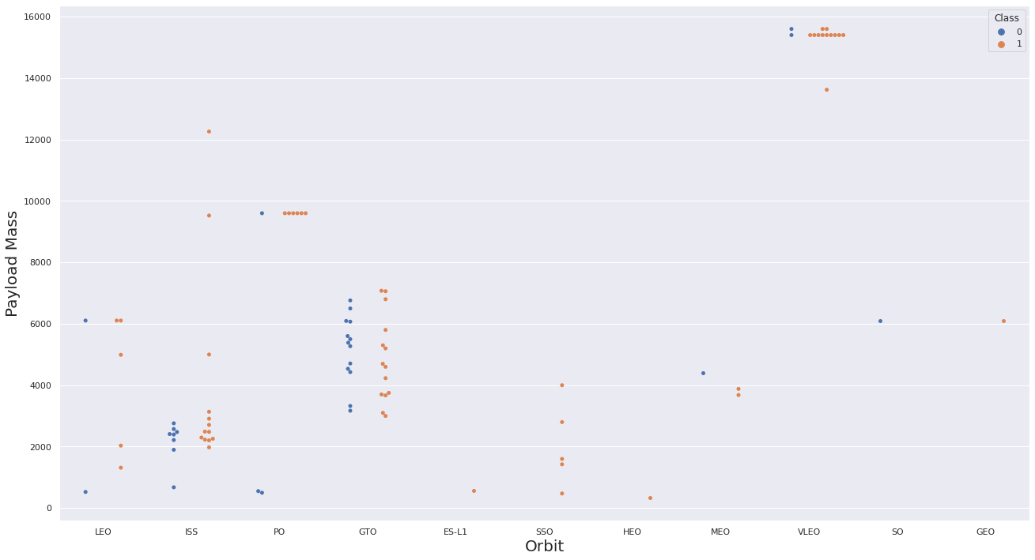
Payload vs. Orbit Type
We observe that heavy payloads have a negative influence on MEO,GTO ,VLEO Orbits
Positive on LEO, ISS Orbits

Slide 26
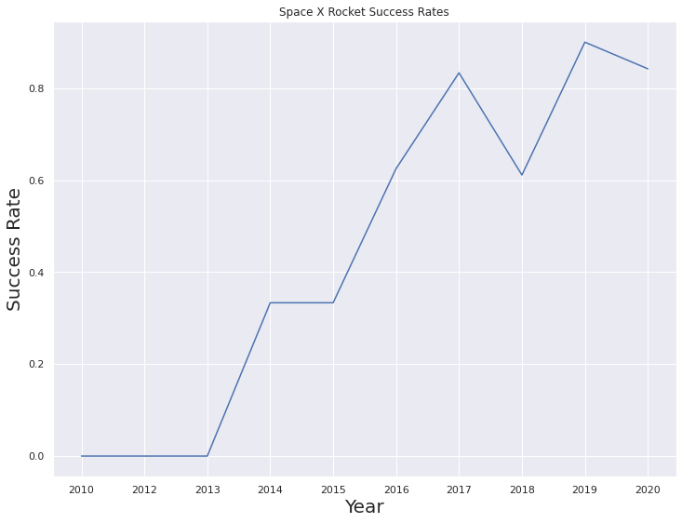
Launch Success Yearly Trend
We can observe that the success rate since 2013 kept increasing relativity through there is a slight dip after 2019

Slide 27
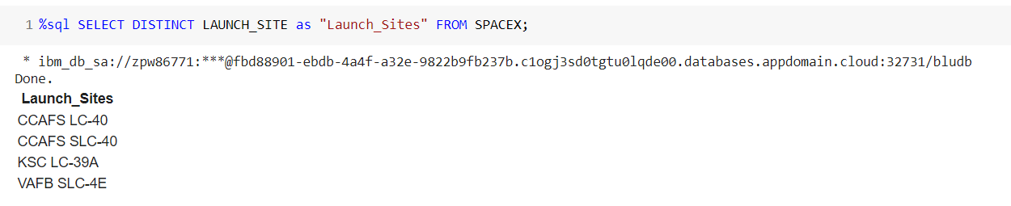
All Launch Site Names
We used the key word DISTINCT to show only unique launch sites from the SpaceX data.

Slide 28
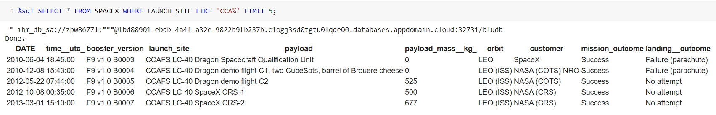
Launch Site Names Begin with 'CCA'
We used the query above to display 5 records where launch sites begin with `CCA`

Slide 29
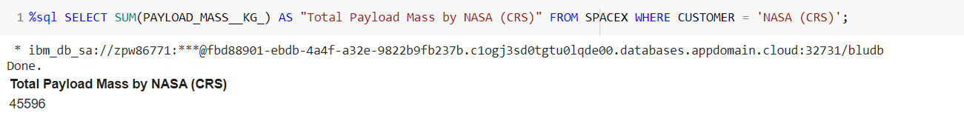
Total Payload Mass
We calculated the total payload carried by boosters from NASA as 45596

Slide 30
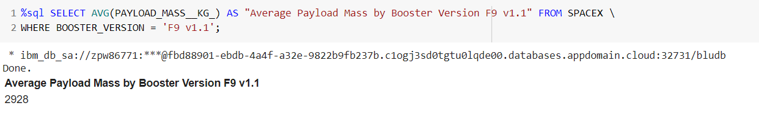
Average Payload Mass by F9 v1.1
We calculated the average payload mass carried by booster version F9 v1.1 as 2928

Slide 31
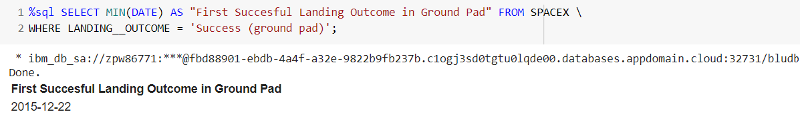
First Successful Ground Landing Date
We observed that the dates of the first successful landing outcome on ground pad was 22nd December 2015

Slide 32
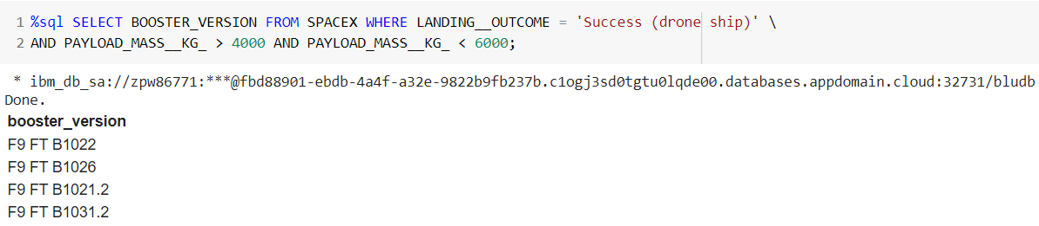
Successful Drone Ship Landing with Payload between 4000 and 6000
We used the WHERE clause to filter for boosters which have successfully landed on drone ship and applied the AND condition to determine successful landing with payload mass greater than 4000 but less than 6000

Slide 33
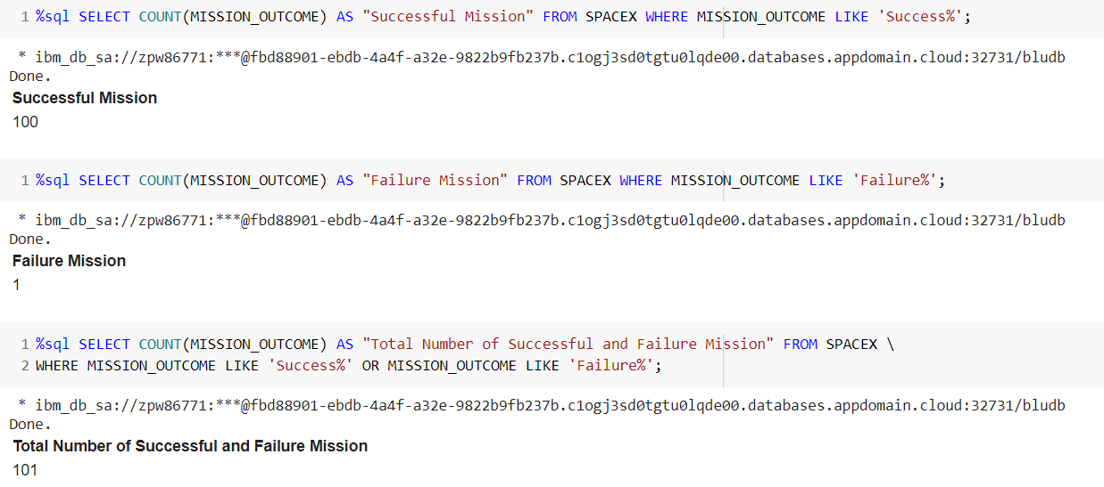
Total Number of Successful and Failure Mission Outcomes
We used wildcard like ‘%’ to filter for WHERE MissionOutcome was a success or a failure.

Slide 34
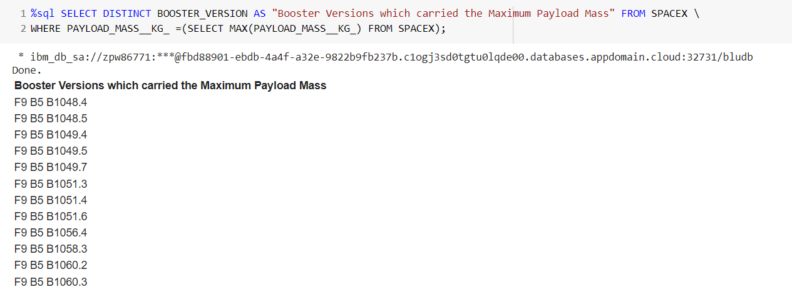
Boosters Carried Maximum Payload
We determined the booster that have carried the maximum payload using a subquery in the WHERE clause and the MAX() function.

Slide 35
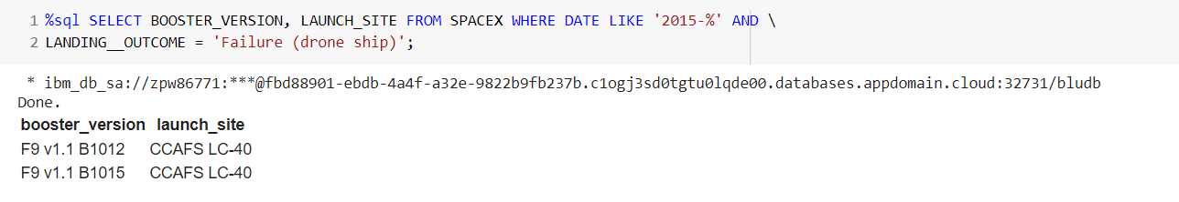
2015 Launch Records
We used a combinations of the WHERE clause, LIKE, AND, and BETWEEN conditions to filter for failed landing outcomes in drone ship, their booster versions, and launch site names for year 2015

Slide 36
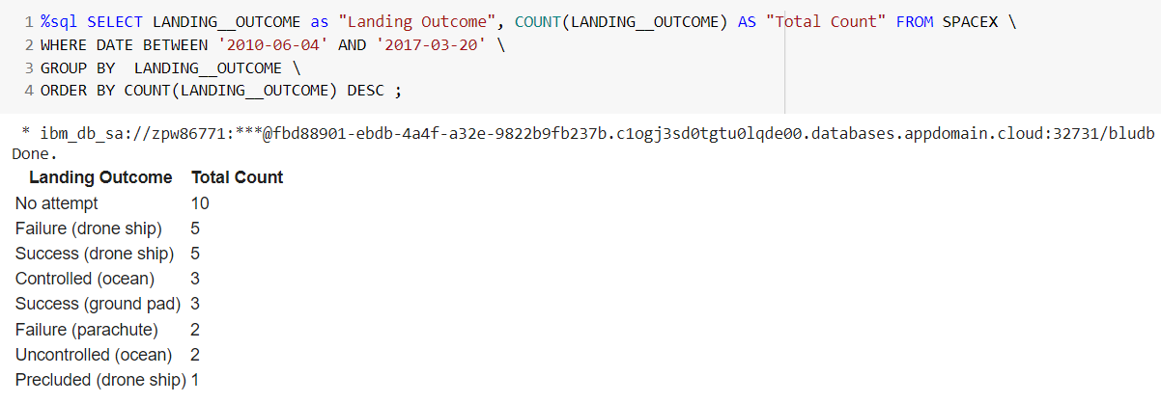
Rank Landing Outcomes Between 2010-06-04 and 2017-03-20
We selected Landing outcomes and the COUNT of landing outcomes from the data and used the WHERE clause to filter for landing outcomes BETWEEN 2010-06-04 to 2010-03-20.
We applied the GROUP BY clause to group the landing outcomes and the ORDER BY clause to order the grouped landing outcome in descending order.

Slide 37

Section 3

Slide 38

All launch sites global map markers

Slide 39

Markers showing launch sites with color labels

Slide 40

Launch Site distance to landmarks

Slide 41

Section 4

Slide 42

Pie chart showing the success percentage achieved by each launch site

Slide 43

Pie chart showing the Launch site with the highest launch success ratio

Slide 44

Scatter plot of Payload vs Launch Outcome for all sites, with different payload selected in the range slider

Slide 45

Section 5

Slide 46
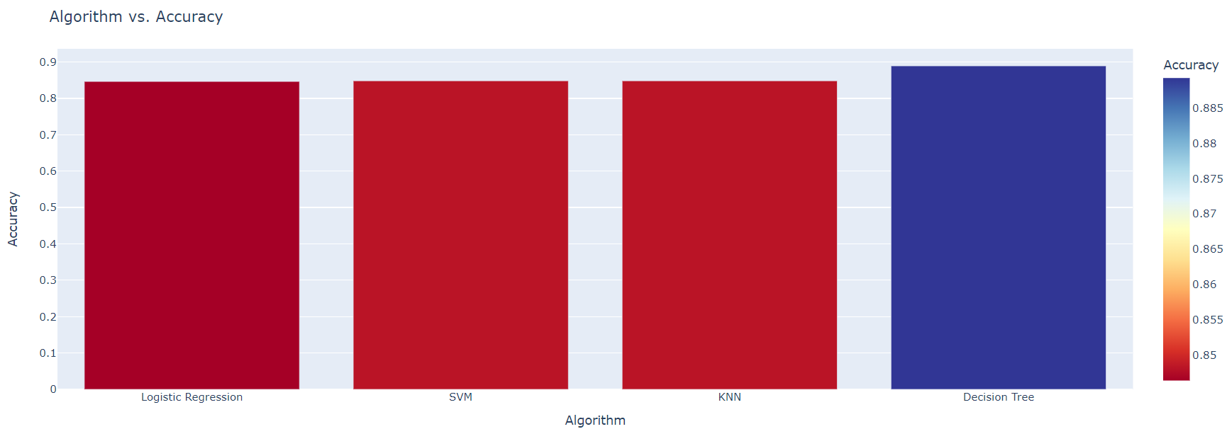
Classification Accuracy
As shown Dicision Tree has the highest classification accuracy

Slide 47
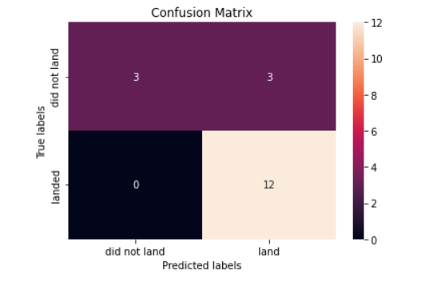
Confusion Matrix
The confusion matrix for the decision tree classifier shows that the classifier can distinguish between the different classes. The major problem is the false positives .i.e., unsuccessful landing marked as successful landing by the classifier.

Slide 48
Conclusions
The larger the flight amount at a launch site, the greater the success rate at a launch site.
Orbits ES-L1, GEO, HEO, SSO, VLEO had the highest success rate.
KSC LC-39A had the most successful launches amongst other sites, although the increasing payload mass appeared to have a negative impact on success.
The Decision tree classifier is the best machine learning algorithm for this task.

Slide 49


